Slide 1
Insta.shopping
Jinhwa Lee
jinhwa014@revature.net

Slide 2






Tools that being used for the App

Slide 3




Functions of Application
See all product list
Search product
Add new products
delete product
update product info
add/delete product stock
See all customer list
search customer
Add new customer
Delete customer
update customer Info
See all order list
Search order by each customer
Place new order
Search order history by date
Search total bill by order number
Search total bill by customer
Cancel the order

Slide 4
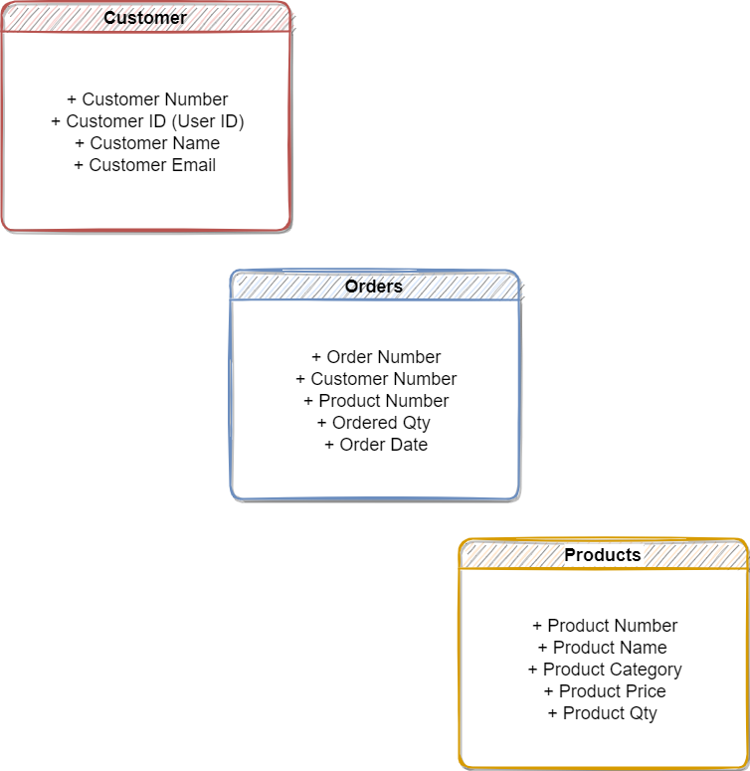
Database Tables & 3NF

